Slide 1



Investigation of Polymer-Ceramic Nanoparticles Composite Films for Use in the Capacitive Storage of Electrical Energy
Terry Stufflebeam
Mentor: Dr. Randy Dillingham

Slide 2
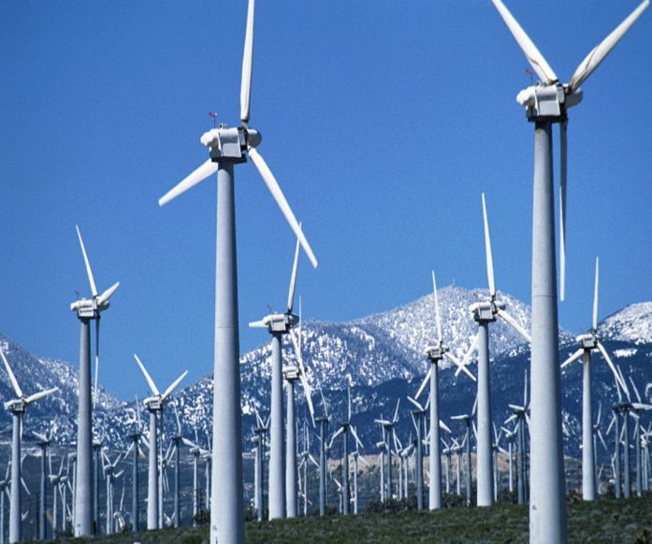
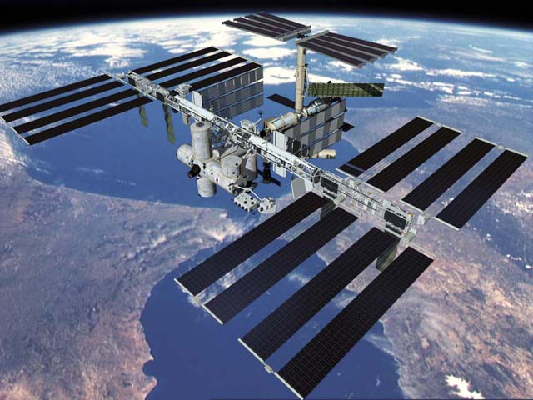
Good Idea, wind and solar energy
The problem, energy deficiencies
The solution, energy storage devices

Slide 3
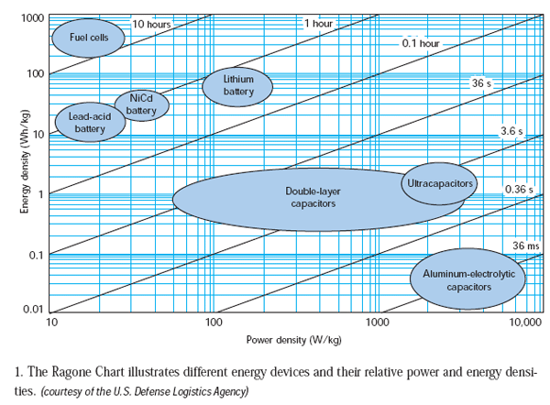
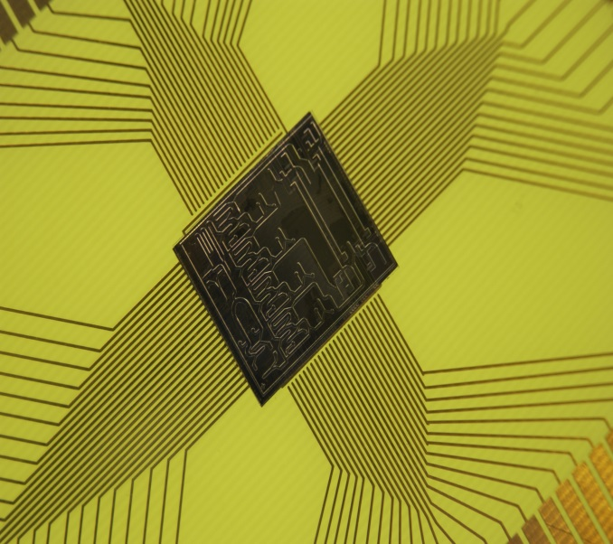
An Increasingly Viable Option
High energy capacitors
Ultra-long life; can be charged millions of times
Low impact on the environment

Slide 4
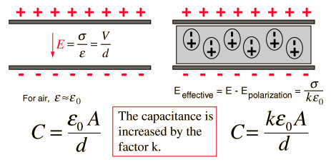
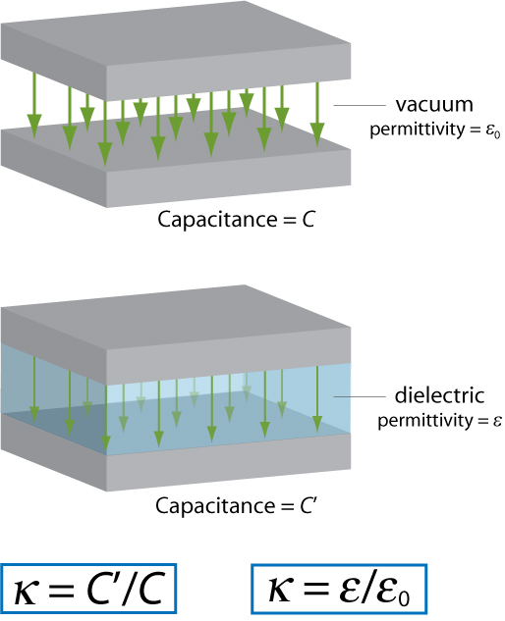
How Capacitors Work

Slide 5
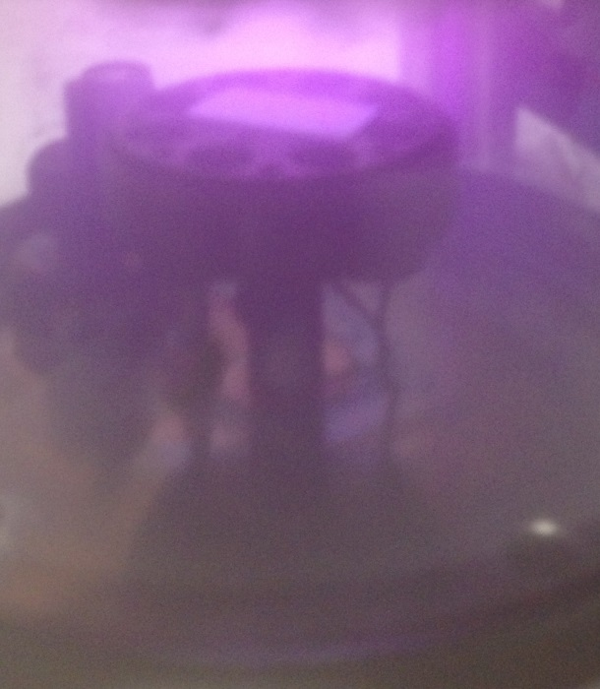
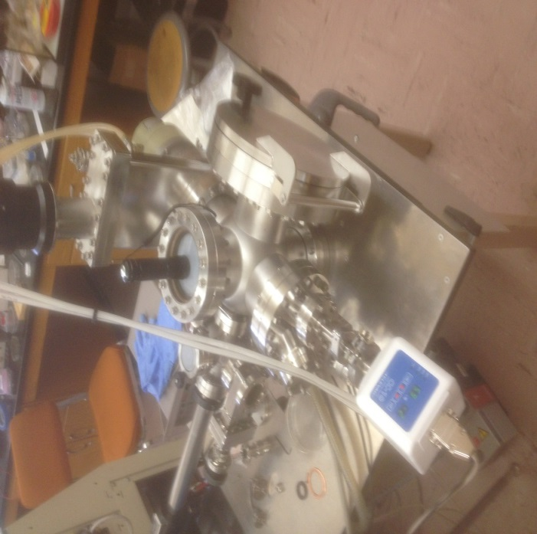
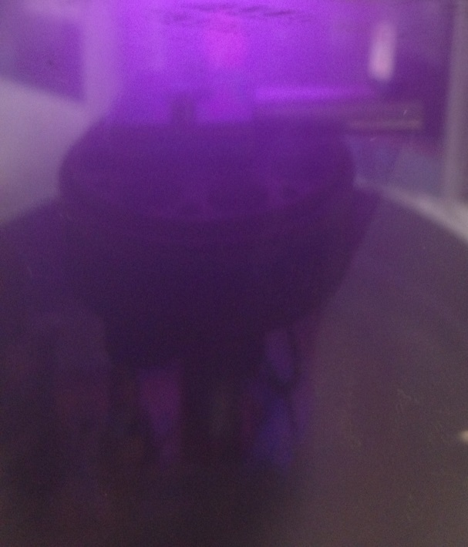
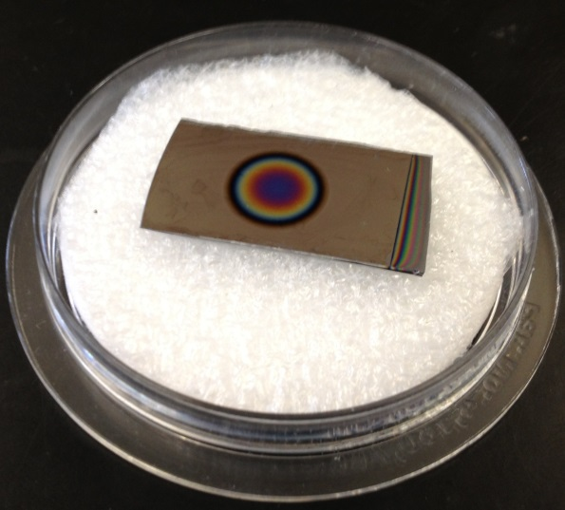
Fabricating the Capacitors
|1cm|

Slide 6
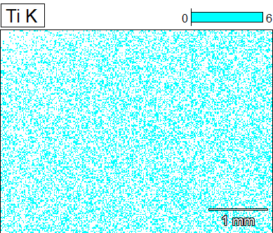
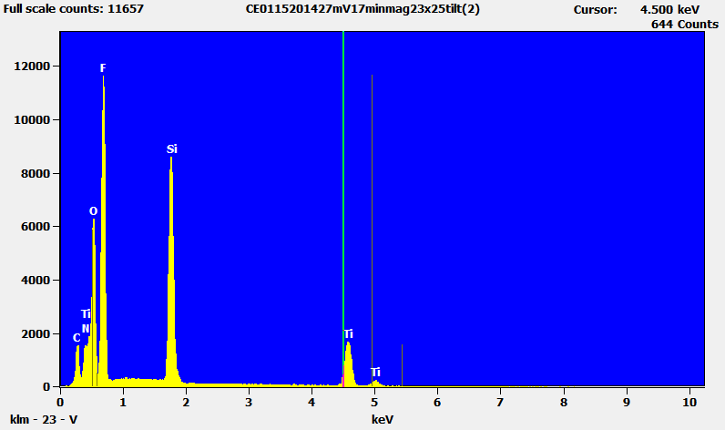

Slide 7
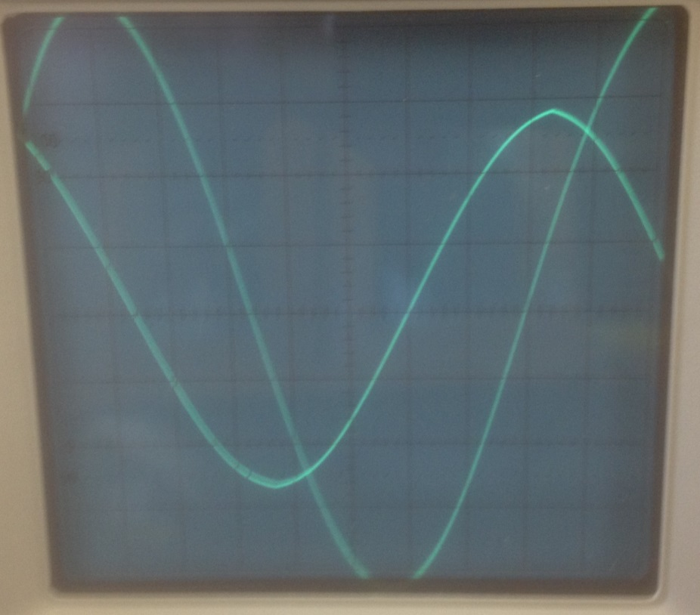
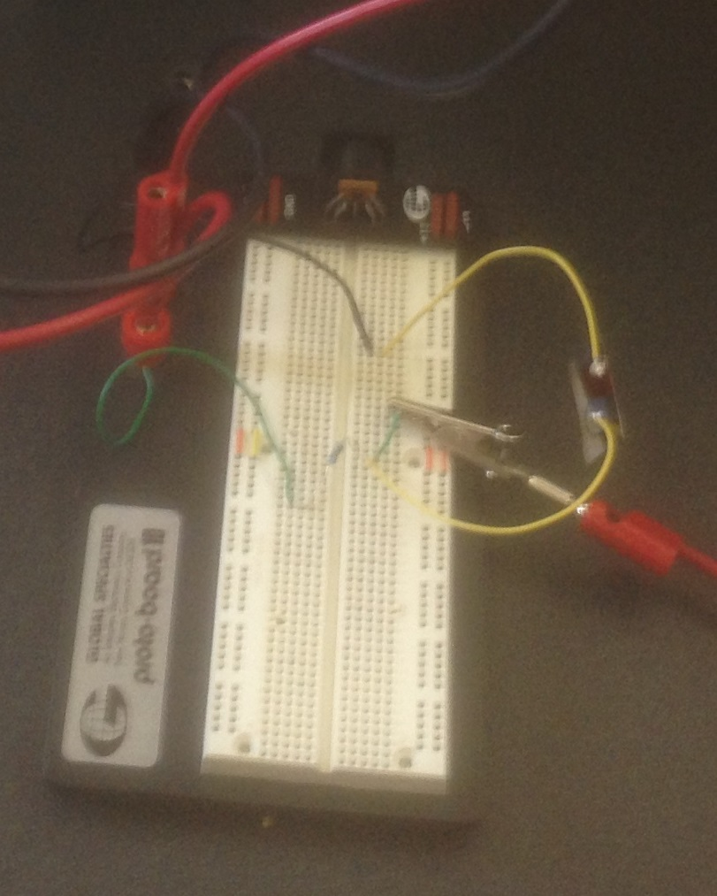
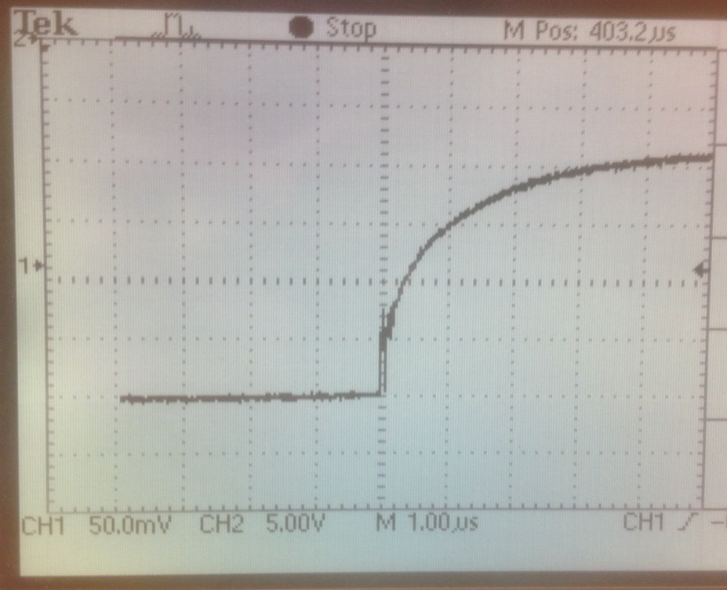
Capacitance Measurements

Slide 8
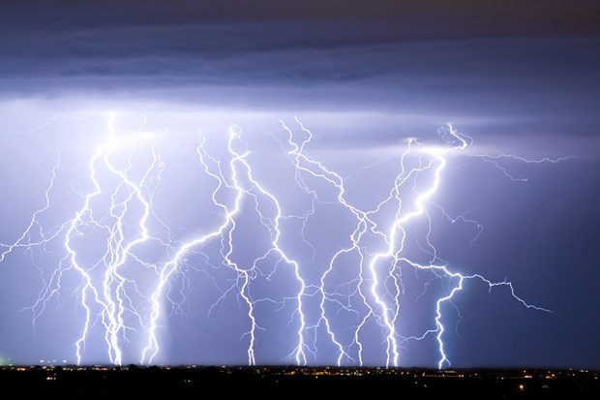
Breakdown Voltage

Slide 9
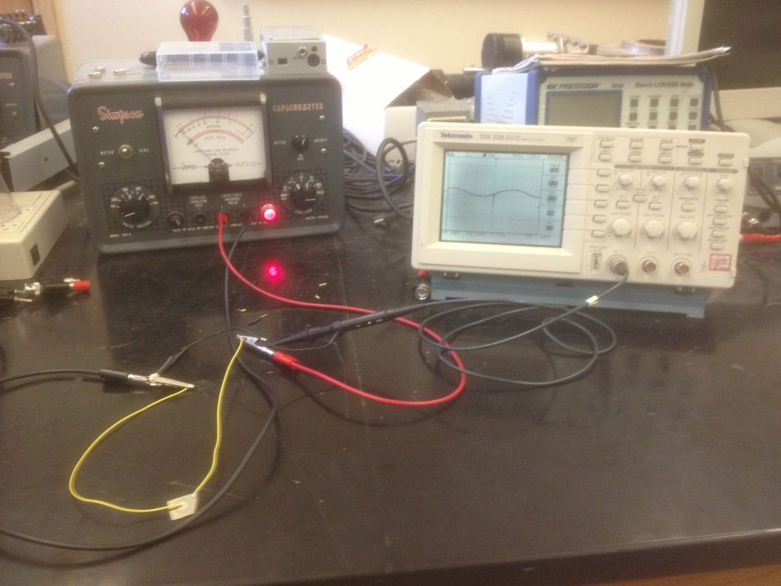
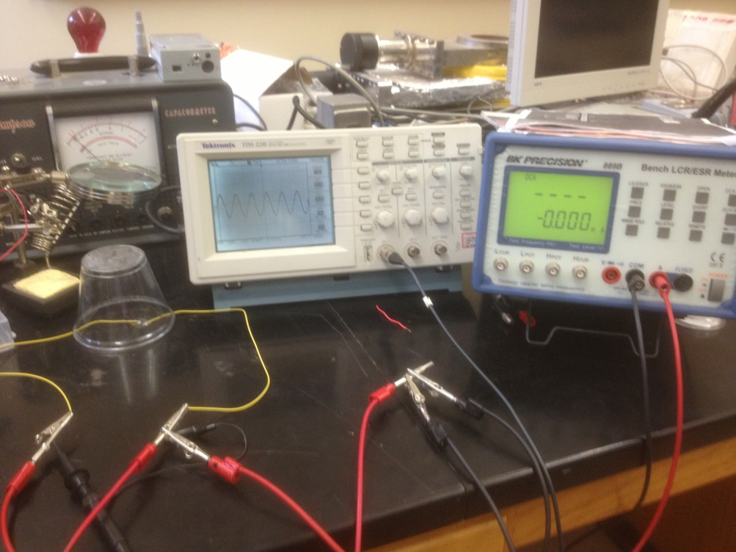
Measuring the Breakdown Voltage

Slide 10
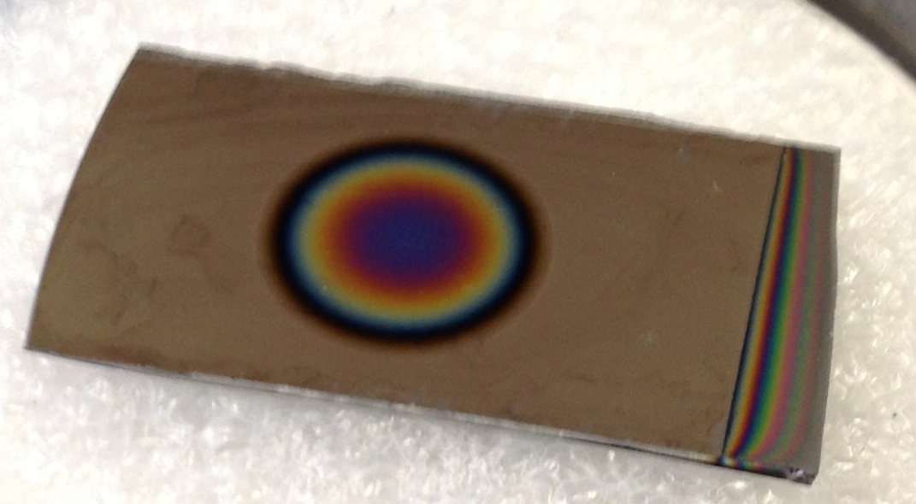
Capacitor Data
Capacitance (in nF) | Dielectric Permittivity | Voltage at Breakdown (in V) | Breakdown Voltage (in MV/m) | Energy Density (in J/cc)
36 | 12 | 25 | 102 | 1.6

Slide 11
Acknowledgments
Dr. Randy Dillingham
Joel Iwagoshi
Crystal Ewen

